Slide 1
GROUP 12
Group members
Zain ul abideen ali 233604
Arfa Imran 233596
Fatima khalid 233526

Slide 2
Introduction
This application is a comprehensive WPF-based management system designed to streamline operations for an organization. It provides distinct roles and functionalities for Admin, Manager, Salesman, and Staff, ensuring efficient workflow and better task management. With features like user management, product inventory handling, and order processing, this application aims to enhance productivity and operational transparency.

Slide 3
Introduction
The system empowers:
Admins to manage users and products effectively.
Managers to oversee staff activities and maintain operational standards.
Salesmen to handle inventory and ensure product availability.
Staff to adjust product inventory statuses and manage orders seamlessly.

Slide 4
Objectives
The primary objective of this application is to facilitate:
Centralized Management: Allow administrators to add, update, and delete users and products efficiently.
Role-based Operations: Provide specific functionalities to Managers, Salesmen, and Staff based on their roles to avoid conflicts and ensure task clarity.
Inventory Optimization: Enable real-time inventory status updates and adjustments, ensuring accuracy and smooth workflow.
Order Processing: Streamline the process of adding, updating, and managing orders for operational efficiency.
Enhanced Monitoring: Allow managers to monitor staff activities, ensuring accountability and productivity.

Slide 5
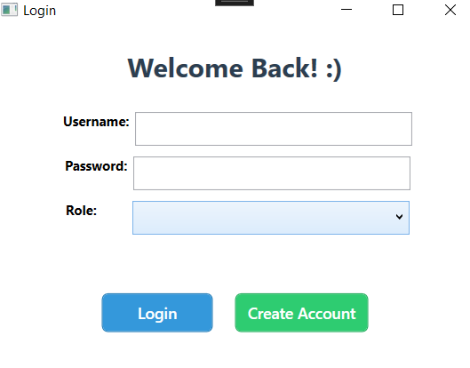
Log In Form
In this Form
User can login existed account.
User can create new account.

Slide 6
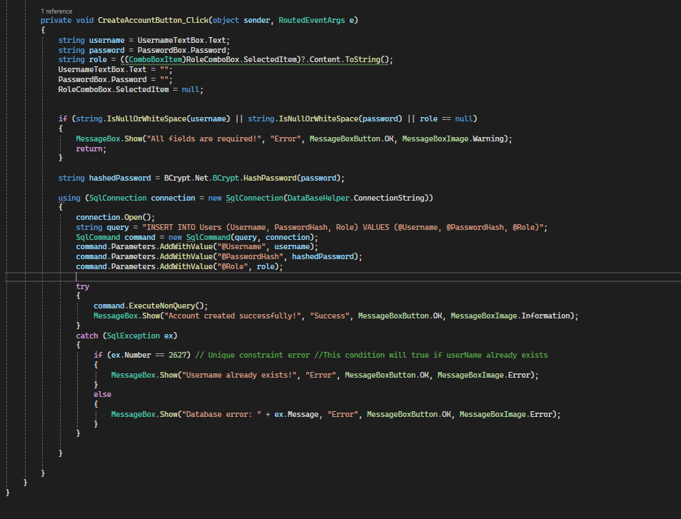

Slide 7
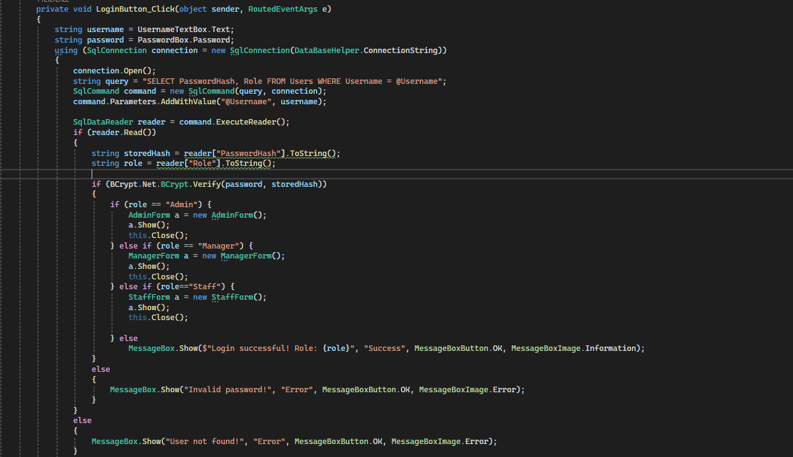

Slide 8
Admin
User Management:
Create, update, and delete user accounts.
Assign or modify roles for users (Admin, Manager, Salesman, Staff).
Product Management:
Add, update, and delete products in the inventory.
Ensure accurate product details and availability status.
Sales man Management:
Add, update, and delete sales man in the inventory.
Role Management:
Oversee and manage permissions for different roles.

Slide 9
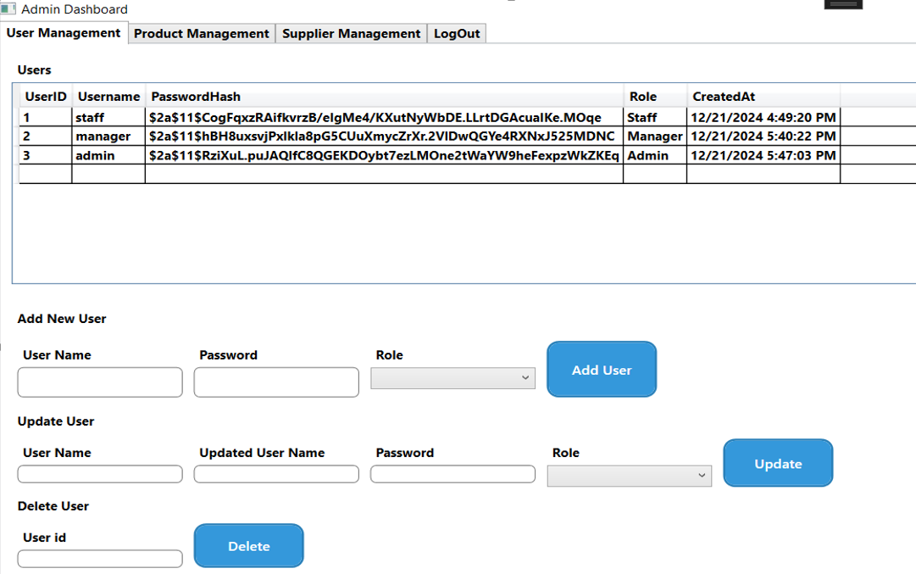
Admin

Slide 10
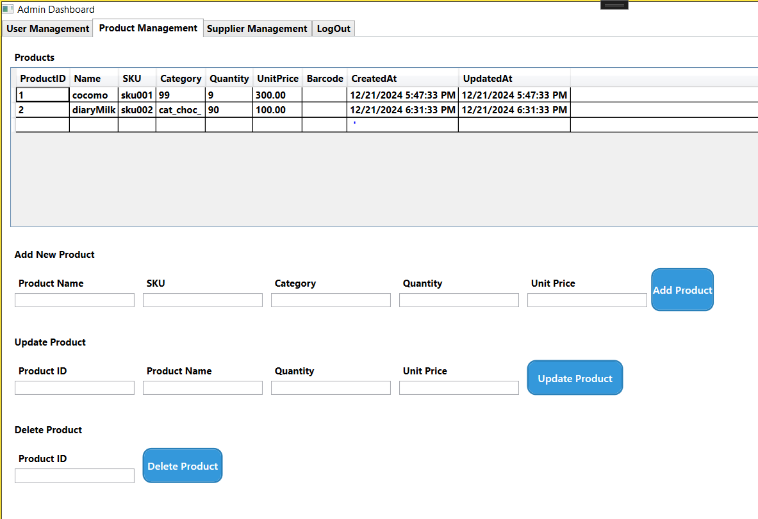
Admin

Slide 11
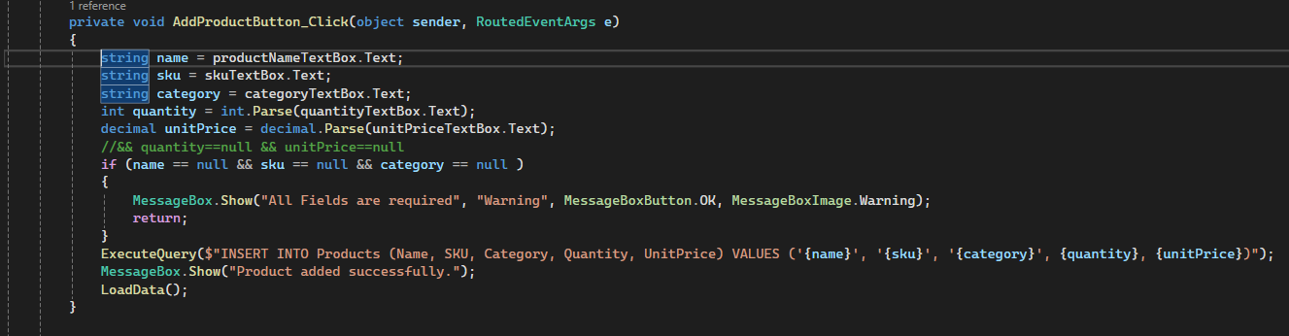
Admin

Slide 12
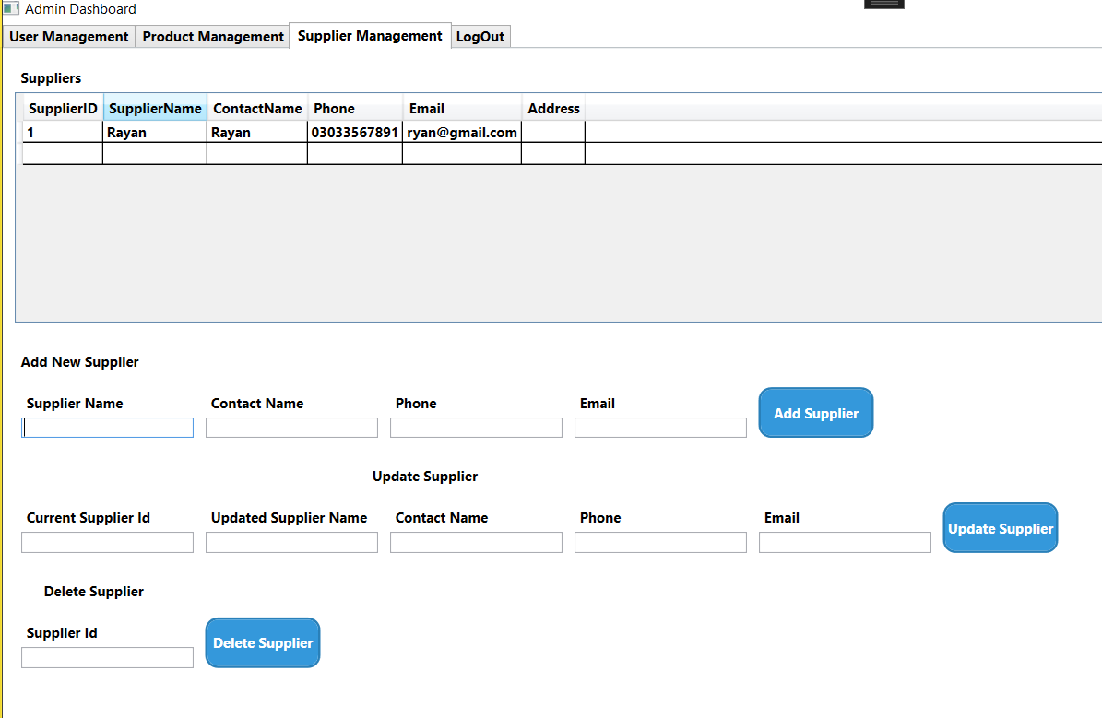
Admin

Slide 13
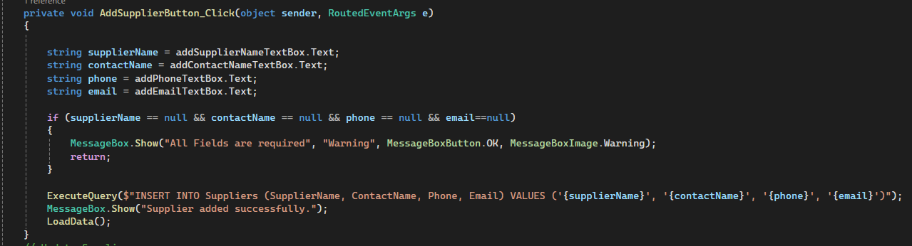
Admin

Slide 14
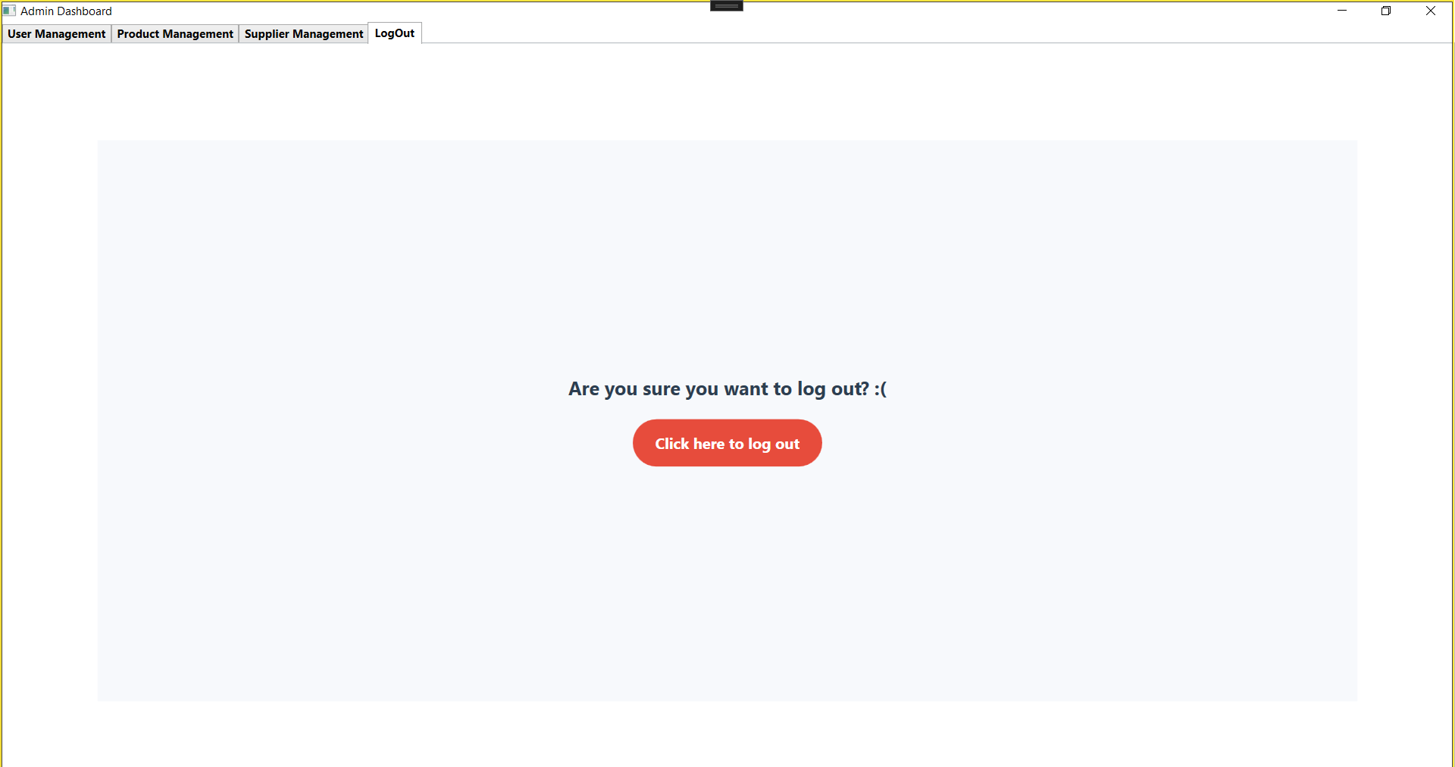
Admin

Slide 15
Staff
Product Viewing:
View the list of products available in the inventory along with their details.
Inventory Status Management:
Update the inventory status of products (e.g., In, Out, Adjust).
Ensure accurate tracking of product movements.
Order Management:
Add new orders with necessary details.
Update existing orders, including changes to quantities or status.
Manage order records efficiently for smooth operations

Slide 16
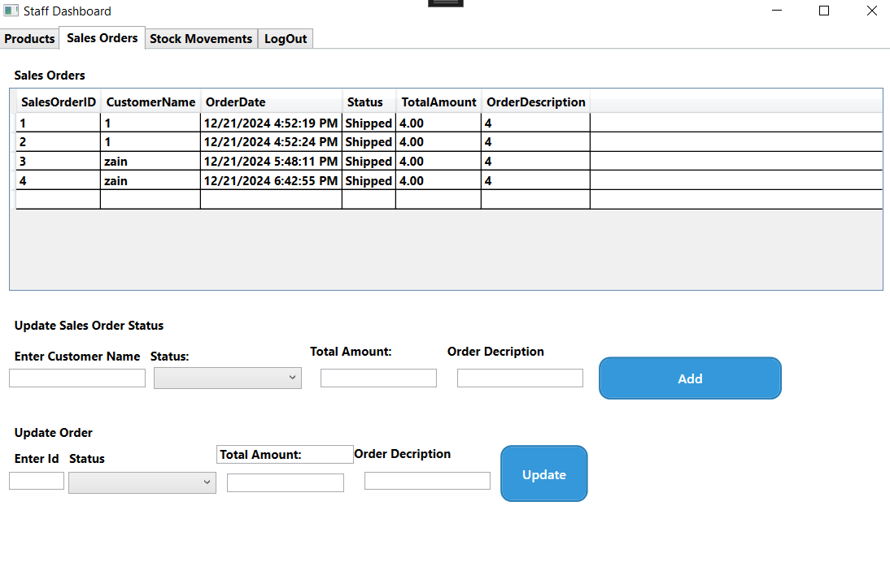
Staff

Slide 17
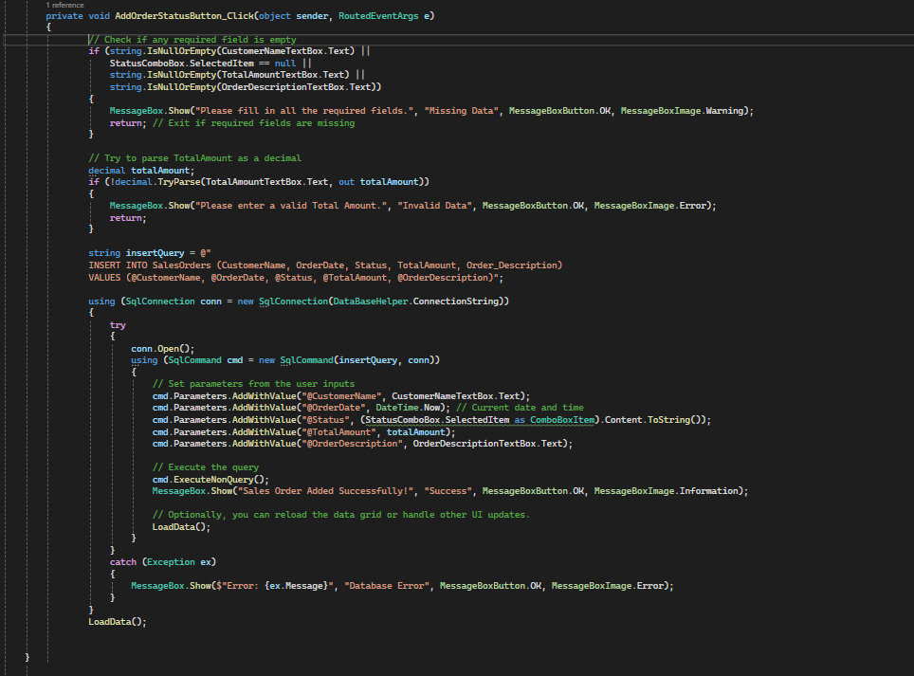
Staff

Slide 18
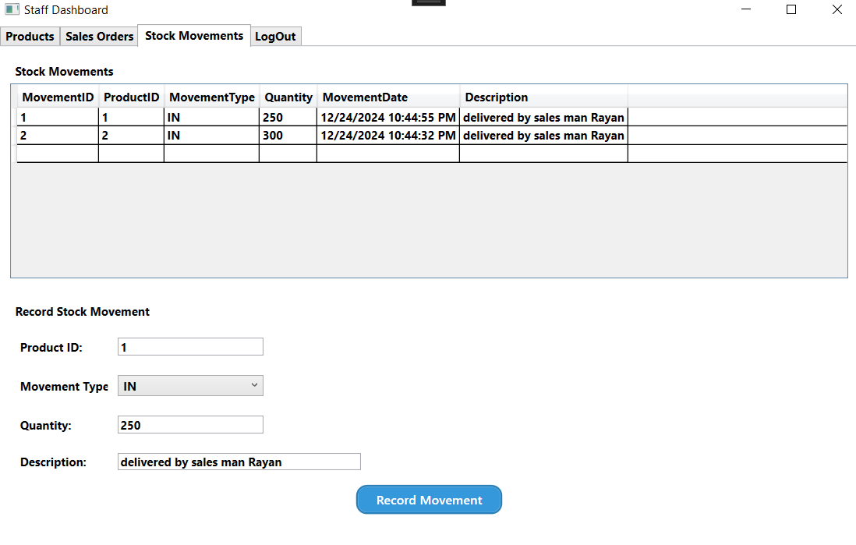
Staff

Slide 19
Manager
Staff Monitoring:
Oversee the activities of staff members, including inventory updates and order management.
Ensure accountability and productivity among team members.
Performance Tracking:
Review and analyze staff performance based on completed tasks and assigned responsibilities.
Inventory Oversight:
Monitor inventory updates made by staff to ensure accuracy and compliance with organizational policies

Slide 20
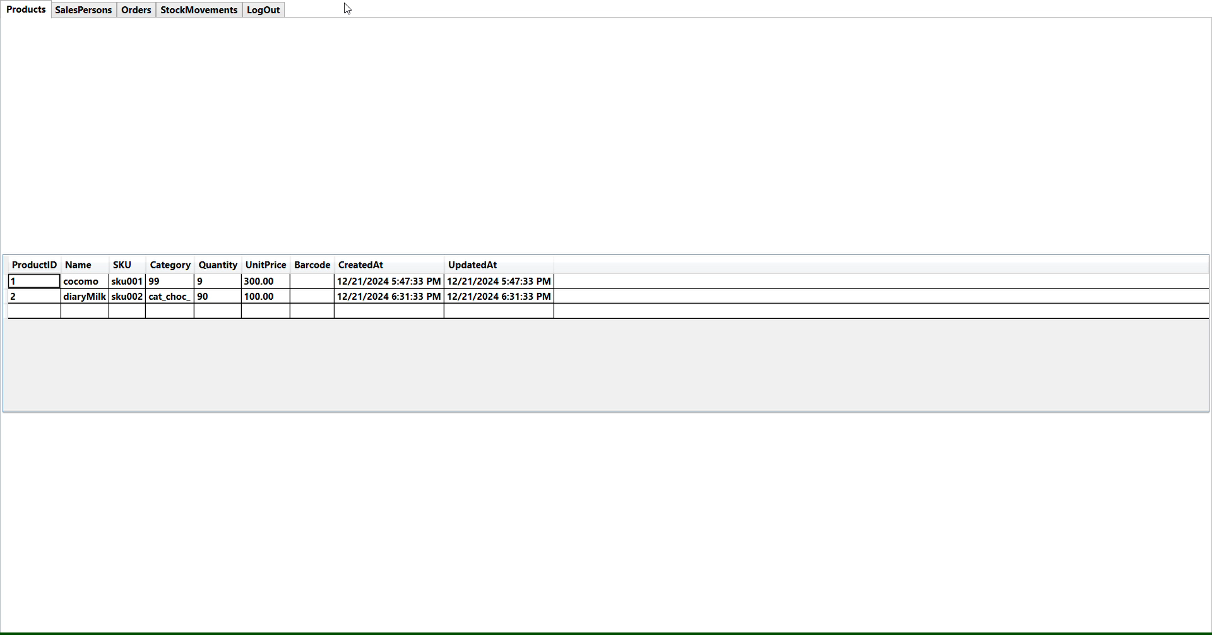
Manager

Slide 21
The End…

